Slide 1


Vega Kiosks
Creating, Deploying & Managing Through Google
Derek Brown | Director of IT
Rochester Hills Public Library | Rochester, MI
SPEED GEEKING | 15 min
IUG 2026 Pre-Conference | The Great ILS-Data Pre-Conference: Quick Lessons With Your Peers | April 12, 2026

Slide 2
Why Google Kiosks?
Built for Flexibility. Private by Design. Simple by Default.
SWAP
SECURE
SIMPLE
Instantly Swappable
Always Private
Radically Simple
Move between Google Admin OUs in seconds
No reimaging. No reconfiguration.
Kids Kiosk at 9am — IIC Kiosk by noon — Express Check by 6pm
Event day: swap to registration or self-checkout on the fly
Chrome OS wipes all history at session end
No patron data is ever saved
No browsing trails — no login required
Privacy enforced at the OS level, not just the app
Purpose-built touch interface — nothing extraneous
Custom Home & Back buttons always visible
Auto-returns to home after 60 sec of inactivity
Designed for walk-up public use with zero training
Move a device to a different OU in Google Admin — less than 60 seconds later, it's a completely different interface.

Slide 3
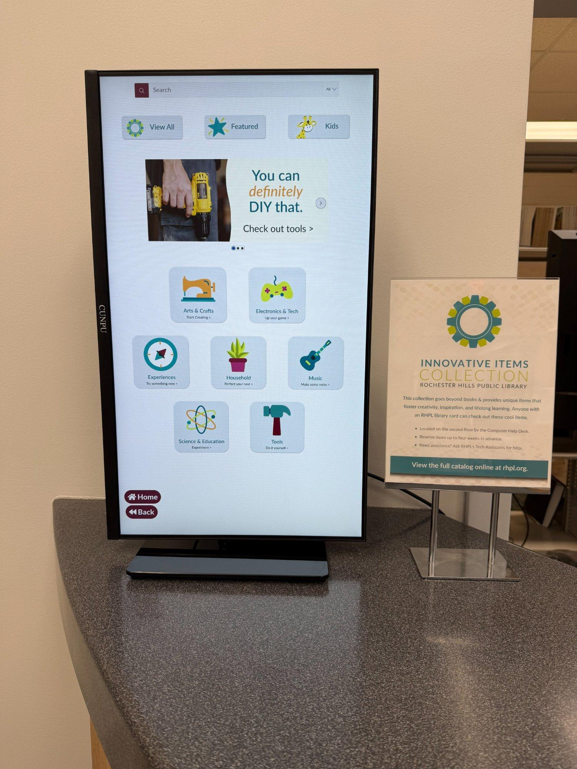
Hardware: Low Cost, High Impact
IIC Discovery Kiosk Build
Touchscreen
CUNPU 27" Nano IPS — 10-point touch, VESA mount
$229.99
Stand
HUANUO VESA Mount — 360 swivel, tempered glass base
$20.49
Computer
HP ChromeBox G4 — WiFi 6E, native Chrome OS
$276.91
ChromeBox Build Total
$527.39
Budget option: Swap ChromeBox for Dell OptiPlex 3060 refurb + Chrome OS Flex -> ~$450-470 total
SAME HARDWARE -> MULTIPLE ROLES
Polaris ExpressCheck Self-Checkout
IIC Kiosk at Rochester Hills Public Library
Same base build + barcode scanner + receipt printer
Same device pool. Different OU in Google Admin. Completely different machine.

Slide 4
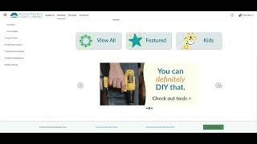
VIDEO WALKTHROUGH
Vega Discover: Building the Kiosk Site
(1) Site Config -> Add New Site (Kiosk) | Experience Settings | Content Scoping
(2) Page Customizations -> Custom Header & Footer Code (where the magic lives)
(3) Homepage Builder -> Showcase Groups | Custom Pills | Hero Carousel
~6 minutes

Slide 5
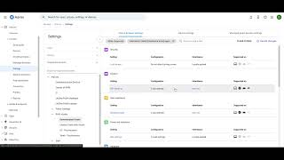
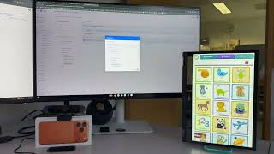
Device Settings Walkthrough
OU Reassignment Demonstration
Google Admin: Device & Session Setup
(1) Apps & Extensions → Kiosks - setting the auto-launch URL
(2) Chrome Settings - user & browser settings, device settings
(3) OU reassignment - IIC to Kids Kiosk and back in seconds (potential live demo)
~3 minutes

Slide 6
CSS
CSS — Prevent Patron Login
Prevent patrons from logging in or making holds
Hides the user panel and the forgot my passcode link — essential for any public kiosk.
/* Remove Login Panel */
/* Hides the user account/login panel — kiosk users should not be able to log in or access account settings */
#user-panel {
display: none;
}

Slide 7
CSS
CSS — Remove Duplicate Vega Header
Remove the duplicate navigation bar Vega injects
Vega forces a second global nav bar even with a premium custom header active.
/* Remove the global header forced by Vega even when using a premium custom header */
/* Hides the second app-global-nav Vega injects into the header — prevents a duplicate navigation bar appearing */
.header>app-global-nav:nth-child(2) {
display: none;
}

Slide 8
CSS
CSS — Scale Down Custom Pill Images
Scale down custom pill images to fit the homepage grid
Without this, pill images appear oversized and crowded. The 80% scale gives breathing room.
/* Scales down images to 80% due to images being too large */
.css-4k03bg {
transform: scale(0.8);
}

Slide 9
CSS
CSS — Home & Back Navigation Buttons
Fixed Home & Back buttons always visible for touch navigation
Fixed-position, 1.5x scale for easy touch, z-index 999999 so they always stay on top.
/* Positions a fixed "Back" button in the lower-left of the screen for kiosk touch navigation */
#b-back {
position: fixed;
top: calc(100vh - 130px);
left: 50px;
background-color: #6f263d;
padding: 10px;
color: white;
border-radius: 30px;
font-size: 22px;
font-weight: bold;
z-index: 999999;
transform: scale(1.5);
}
/* Styles the anchor tag inside the back button — removes underline and keeps text white */
#b-back a {
color: white;
text-decoration: none;
}
/* Positions a fixed "Home" button just above the back button in the lower-left for kiosk navigation */
#b-home {
position: fixed;
top: calc(100vh - 200px);
left: 50px;
background-color: #6f263d;
padding: 10px;
color: white;
border-radius: 30px;
font-size: 22px;
font-weight: bold;
z-index: 999999;
transform: scale(1.5);
}
/* Styles the anchor tag inside the home button — removes underline and keeps text white */
#b-home a {
color: white;
text-decoration: none;
}

Slide 10
JavaScript
JS — Image Link Mapping (1 of 3)
Map homepage category images to filtered catalog search URLs
Each src matches an image filename. Font is small to show the full unabridged URLs on one line each.
/* Maps image filename fragments to their corresponding filtered catalog search URLs.
Each entry links a homepage banner/subject image to a specific collection or material type in the catalog. */
const imageLinks = [
{ src: 'WQ2r4', url: 'https://mbiic-rhpl.na3.iiivega.com/search?query=*&searchType=everything&pageSize=40&locationIds=15&pageNum=0&materialTypeIds=23' },
{ src: 'ArtsCrafts', url: 'https://mbiic-rhpl.na3.iiivega.com/search?query=*&searchType=everything&pageSize=40&locationIds=15&pageNum=0&materialTypeIds=23&collectionIds=130' },
{ src: 'Electronics', url: 'https://mbiic-rhpl.na3.iiivega.com/search?query=*&searchType=everything&pageSize=40&locationIds=15&pageNum=0&materialTypeIds=23&collectionIds=131' },
{ src: 'Experiences', url: 'https://mbiic-rhpl.na3.iiivega.com/search?query=*&searchType=everything&pageSize=40&locationIds=15&pageNum=0&materialTypeIds=23&collectionIds=132' },
{ src: 'Household', url: 'https://mbiic-rhpl.na3.iiivega.com/search?query=*&searchType=everything&pageSize=40&locationIds=15&pageNum=0&materialTypeIds=23&collectionIds=134' },
{ src: 'Tools', url: 'https://mbiic-rhpl.na3.iiivega.com/search?query=*&searchType=everything&pageSize=40&locationIds=15&pageNum=0&materialTypeIds=23&collectionIds=137' },
{ src: 'Music', url: 'https://mbiic-rhpl.na3.iiivega.com/search?query=*&searchType=everything&pageSize=40&locationIds=15&pageNum=0&materialTypeIds=23&collectionIds=135' },
{ src: 'ngHdl', url: 'https://mbiic-rhpl.na3.iiivega.com/search?query=*&searchType=everything&pageSize=40&locationIds=15&pageNum=0&materialTypeIds=23&collectionIds=136' }
];

Slide 11
JavaScript
CONTINUED
JS — Click Listener & DOM Scan (2 of 3)
Find the image for the links, and inject the link on top
This allows all links to open in one window, instead of opening more tabs. Kiosks generally don’t support multiple tabs.
/* Scans the page for images that haven't had a click listener attached yet.
When an image is clicked, navigates to its corresponding catalog search URL after a short delay
to allow any Vega internal click handlers to fire first. */
function addClickListenerToImage() {
let allBound = true;
imageLinks.forEach(function({ src, url }) {
const img = document.querySelector('img[src*="' + src + '"]:not([data-click-bound])');
if (img) {
img.setAttribute('data-click-bound', 'true');
img.addEventListener('click', function() {
setTimeout(function() {
window.location.href = url;
}, 100);
});
console.log('Listener bound for: ' + src);
} else if (!document.querySelector('img[src*="' + src + '"')) {
/* Image not yet in DOM */
allBound = false;
}
});
/* Once every image has been found, stop polling and prevent memory leaks by reclaiming resources. */
if (allBound) {
clearInterval(poller);
observer.disconnect();
console.log('All listeners bound');
}
}

Slide 12
JavaScript
CONTINUED
JS — Polling & DOM Observation (3 of 3)
Make sure all images receive the proper link, especially if the user re-navigates to the home page.
Links will be re-injected if the home page is reloaded by natural navigation.
/* Polls every 500ms to catch images that load after the page was served
(Vega lazy-renders content, so images may not be present on initial page load) */
const poller = setInterval(addClickListenerToImage, 500);
/* Watches in case a new image is rendered, checks the new images, and checks the file names once to make sure it’s not a listed image */
const observer = new MutationObserver(function() {
addClickListenerToImage();
});
document.addEventListener('DOMContentLoaded', function() {
addClickListenerToImage();
observer.observe(document.body, {
childList: true,
subtree: true,
attributes: true,
attributeFilter: ['src']
});
});

Slide 13
JavaScript
JS — Inactivity Timer
Auto-return to home page after 60 seconds of inactivity
startTimer() activates on first interaction. resetTimer() clears and restarts the 60-second countdown.
let inactivityTimer;
let timerActive = false;
/* Change this to your specific URL/path */
const HOME_URL = '/';
/* Activates the inactivity timer on the first user interaction — only fires once per page load */
function startTimer() {
if (timerActive) return;
timerActive = true;
console.log('First interaction detected. Inactivity timer is now active.');
resetTimer();
}
/* Clears and restarts the 60-second countdown.
If no interaction occurs within 60 seconds, the kiosk automatically redirects to the home page. */
function resetTimer() {
clearTimeout(inactivityTimer);
console.log('Inactivity timer reset. Redirecting in 60 seconds if no interaction...');
inactivityTimer = setTimeout(() => {
console.log('No interaction detected for 60 seconds. Redirecting to home page...');
window.location.href = HOME_URL;
}, 60000);
}
/* On the home page, the timer only activates after the first touch or click.
This prevents an idle kiosk from immediately bouncing back to home before anyone has interacted with it. */
if (window.location.pathname === HOME_URL) {
console.log('On home page. Waiting for first click or touch...');
const activationEvents = ['click', 'touchstart'];
activationEvents.forEach(event => {
document.addEventListener(event, function onFirstInteraction(e) {
startTimer();
/* Remove the activation listener after first interaction so startTimer is not called again */
document.removeEventListener(event, onFirstInteraction);
});
});
} else {
/* On all other pages, start the inactivity timer immediately — the user is already browsing */
console.log('Inactivity tracker initialized on ' + window.location.pathname);
timerActive = true;
resetTimer();
}
/* Resets the inactivity countdown on any meaningful user interaction across all pages */
const events = ['mousemove', 'mousedown', 'keydown', 'touchstart', 'scroll', 'click'];
events.forEach(event => {
document.addEventListener(event, (e) => {
if (!timerActive) return;
console.log('Interaction detected: [' + e.type + ']. Restarting timer.');
resetTimer();
});
});

Slide 14
JavaScript
JS — Link Override & DOM Watcher
Force Vega to load all links in one window
This prevents any default Vega links from opening in a new tab, to allow for Kiosk flexibility
/* Log everything to console to be sure */
(function() {
const _log = (msg) => console.log(`[fix-blank] ${Date.now()} — ${msg}`);
/* Check if any links will try to load in a new window or tab */
function fixLinks(root) {
if (!root) return;
let count = 0;
if (root.tagName === 'A' && root.target === '_blank') {
root.removeAttribute('target'); count++;
}
root.querySelectorAll && root.querySelectorAll('a[target="_blank"]').forEach(a => {
a.removeAttribute('target'); count++;
});
if (count > 0) _log(`fixed ${count} link(s) via ${root.tagName || 'root'}`);
return count;
}
/* Do a sweep and replace found links on the initial load*/
['pushState', 'replaceState'].forEach(method => {
const orig = history[method].bind(history);
history[method] = function(...args) {
_log(`${method} → ${args[2]}`);
orig(...args);
[200, 600, 1200, 2500].forEach(ms =>
setTimeout(() => {
const n = document.querySelectorAll('a[target="_blank"]').length;
_log(`sweep +${ms}ms after ${method}: found ${n}`);
fixLinks(document.body);
}, ms));
};
});
/* Keep an observer up, for links that load after the page is served */
const blankLinkObserver = new MutationObserver(mutations => {
mutations.forEach(m => {
m.addedNodes.forEach(n => {
if (n.nodeType !== 1) return;
const self = n.tagName === 'A' && n.getAttribute('target') === '_blank';
const desc = n.querySelectorAll
? n.querySelectorAll('a[target="_blank"]').length : 0;
if (self || desc > 0)
_log(`observer: added ${n.tagName} with ${desc+(self?1:0)} blank link(s)`);
fixLinks(n);
});
if (m.type === 'attributes' && m.target.tagName === 'A'
&& m.target.getAttribute('target') === '_blank') {
_log(`observer: attribute target=_blank on .${m.target.className}`);
m.target.removeAttribute('target');
}
});
});
blankLinkObserver.observe(document.body, {
childList: true, subtree: true, attributes: true,
attributeFilter: ['target']
});
_log('observer attached to document.body');
/* If a link is found, log it to the console and replace it */
[0, 500, 1500, 3000].forEach(ms =>
setTimeout(() => {
const n = document.querySelectorAll('a[target="_blank"]').length;
_log(`initial sweep +${ms}ms: found ${n}`);
fixLinks(document.body);
}, ms)
);
})();

Slide 15






Scan, Explore & Connect
IIC Full Catalog
IIC Kiosk (Stripped)
Kids Full Catalog
Kids Subject Kiosk
iic.rhpl.org
mbiic-rhpl.na3.iiivega.com
kids.rhpl.org
mbksub-rhpl.na3.iiivega.com
Vega Custom Code on GitHub
Derek Brown | Director of IT
Vega Kiosk Presentation
All custom CSS, JS & header/footer code
Free to use and adapt for your library
derek.brown@rhpl.org
This will link directly to this presentation and it will be uploaded to the IUG Clearinghouse after the event.
(248) 650-7123
Find me again at IUG 2026 this week:
Tue Apr 14, 10:30am | Vega in Action: A Community Showcase of Customer Implementations (Kane)
Tue Apr 14, 4:30pm | Lightning Rounds: From Door to Desktop - Identity Provider Integration (Ballroom G)
Wed Apr 15, 9:00am | Lightning Rounds: Start Your Regional IUG Group (Ballroom G)
Wed Apr 15, 1:30pm | All Things Vega Forum (Kane)
"Happy to share code, answer questions, or geek out about kiosks. Just ask."

